Slide 1
DO NOT USE THIS

Slide 2
Blindness Detection(Diabetic Retinopathy) using Deep Learning Techniques
Presenters:
Nicholas Gustafson 😎
Tejaswi Gadde
Hari Chandana Datla
Lakshmi Chandana Shaik
Shiva Shettar

Slide 3
Agenda
Introduction
Goal
Training Data
Deep Learning Models to Use
Methodologies Used

Slide 4
Introduction
It is estimated that by 2040 approximately 600 million people will suffer with diabetes, of which one-third are expected to get affected with diabetic retinopathy, the leading cause of vision loss in adults.
The early stage of this is mild nonproliferative (NPDR) which is crucial and can be treated with timely diagnosis.
With the help of AI and Machine Learning one can eliminate the need of a healthcare professional to look and analyse the images which is otherwise time consuming.

Slide 5
Goal
Explore the application of state of the art deep learning techniques for ordinal image classification on images of diabetic retinopathy.
Understand Transformers “Attention is all you need” (Vaswani et al, 2017)
Apply state of the art CNNs, densenet, and even new visual transformer techniques to classify the images.
Using new visual transformer techniques, try and improve the competitive results on the Kaggle.

Slide 6
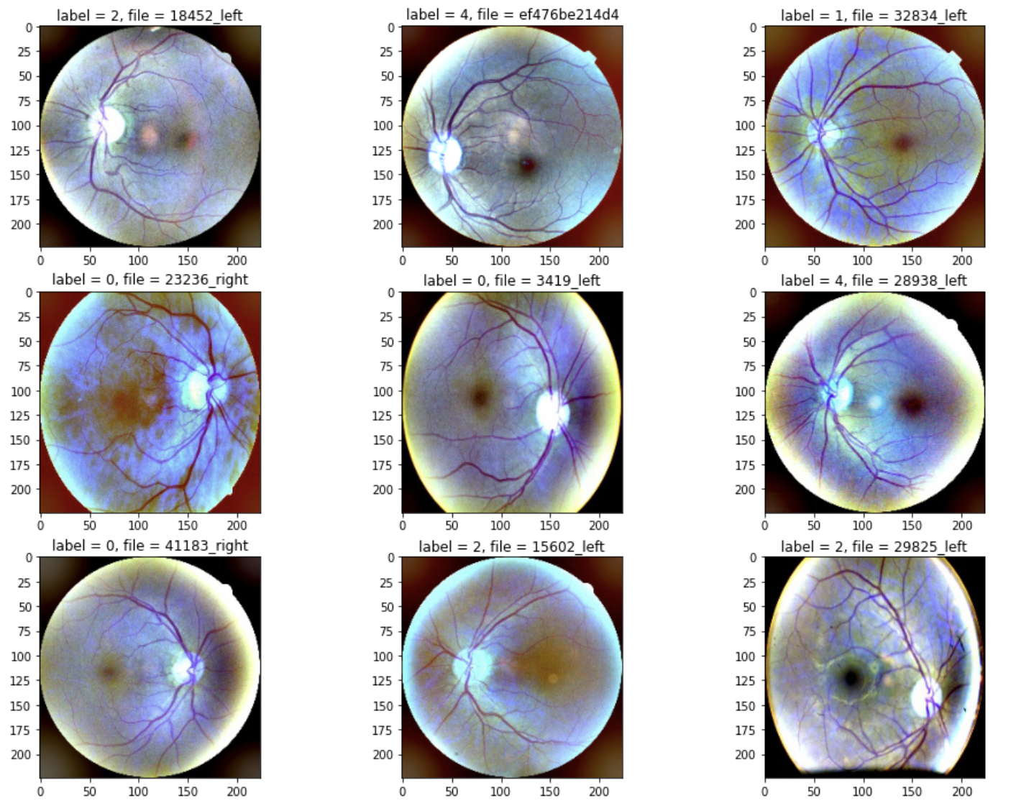
The Training Data: 38,788 Images of eyes with labels
All images were transformed to 244x244 .jpg image of the eye takes up max area
Gaussian blur was added as a filter
Preprocessed data as a public Kaggle dataset here: https://www.kaggle.com/pineapplepencil/custom-transform-blindness-2019
Nicholas Gustafson is pineapplepencil on Kaggle, so if you want to see more, go to this profile.

Slide 7
What types of models can we use?
The winning model for the 2019 Kaggle competition was an ensemble of :
2 x inception_resnet_v2, input size 512
2 x inception_v4, input size 512
2 x seresnext50, input size 512
2 x seresnext101, input size 384
Which is very nice, but there is a new kid on the block called the transformer, and it has already taken the world of NLP by storm. Could a transformer model, in this case a visual transformer (ViT), take the over the world of image classification? Or do we have a long way to go before transformers take the place of deep CNNs?

Slide 8
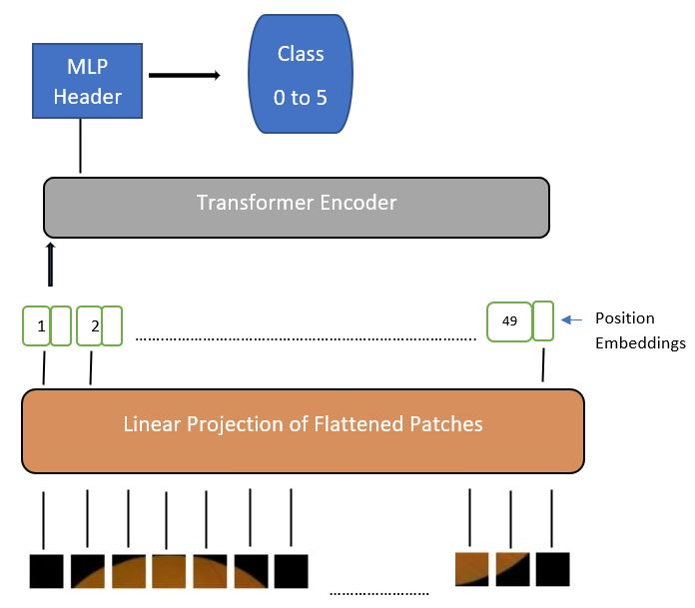
What are Transformers?
A model that uses attention to boost the speed with which these models can be trained
Standard Model in NLP Tasks
Only consists of Attention Modules which is a kind of correlation of vectorized words with each other to get the final prediction.
The encoder inputs first flow through a self-attention layer – a layer that helps the encoder look at other words in the input sentence as it encodes a specific word.
The outputs of the self-attention layer are fed to a feed-forward neural network. The exact same feed-forward network is independently applied to each position.
The decoder has both those layers, but between them is an attention layer that helps the decoder focus on relevant parts of the input sentence.
Vision Transformers
Images are split into fixed-size patches, linearly embed each of them, add position embeddings, and feed the resulting sequence of vectors to a standard Transformer encoder. In order to perform classification, we use the standard approach of adding an extra learnable “classification token” to the sequence
Notes:
We split an image into fixed-size patches, linearly embed each of them, add position embeddings, and feed the resulting sequence of vectors to a standard Transformer encoder. In order to perform classification, we use the standard approach of adding an extra learnable “classification token” to the sequence.

Slide 9
Vision Transformers
Linformer ViT
LeViT
CaiT ViT
CVT

Slide 10
Methodology
Images scaled down to 244x244, smaller than the images used in the winning solution.
given these 38,788 images and multi labels
train a model to predict disease activity from 0, 1, 2, 3, to 4
training the models using pytorch on a public Kaggle kernel with a GPU accelerator.
To make give the transformers a little in-house competition, we will also be training a simple CNN a densenet. These models were implemented with tensorflow instead of pyTorch because everyone should add a little variety to their life.

Slide 11
Limitations
To really put the models to the test, we won’t be creating ensembles of different transformers. We will evaluate each model individually, and on images scaled down to 244x244, smaller than the images used in the winning solution.
We will be training the models using pytorch on a public Kaggle kernel with a GPU accelerator.
To make give the transformers a little in-house competition, we will also be training a simple CNN a densenet. These models were implemented with tensorflow instead of pyTorch because everyone should add a little variety to their life.

Slide 12
Quadratic Weighted Kappa
A metric used to calculate the similarity between predictions and actuals
The scores range from 1 to -1.
1 is the perfect score that states both predictions and actuals are same.
The least possible score is -1 which is given when the predictions are furthest away from actuals.
The scores of our models in comparison to the winning solutions score:
Model | Quadratic Weighted Kappa Score
Winning Solution (Large Ensemble) | 0.936129
Our Best Model (Densenet) | 0.87790
Our Small Simple CNN | 0.629998
Our Best ViT | 0.010156

